Slide 1

Clean Water…
…Clean Beaches
Los Angeles County Flood Control District
Water Quality Funding Initiative
Southern California Water Dialogue
June 22, 2011

Slide 2
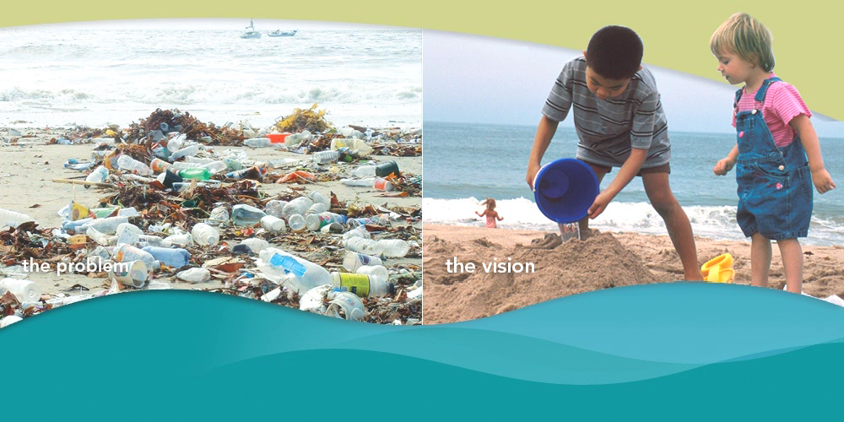
Cleaning Up Rivers, Lakes, Beaches, & Coastal Waters
The Problem
The Vision

Slide 3
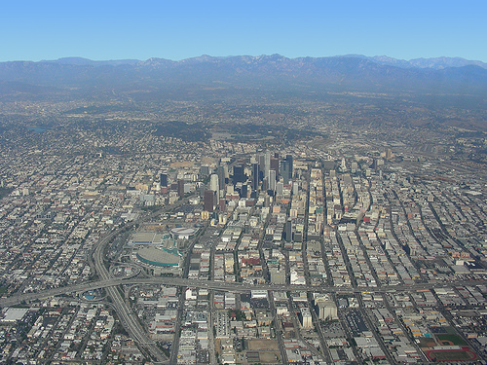
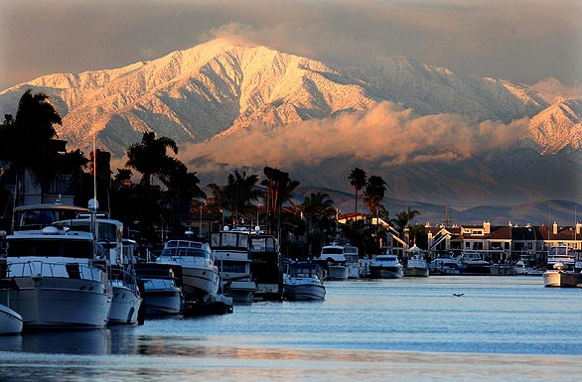
Los Angeles County Flood Control District
Where We Live, Work and Play
  10 + million residents – 25% of State CA population
  2,752 sq. miles
  86 cities
  100 Unincorporated Communities

Slide 4
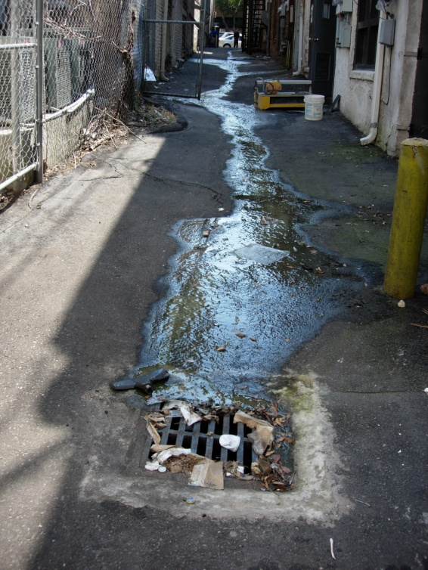
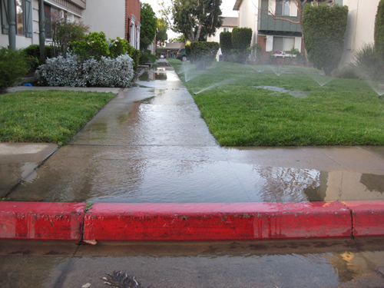
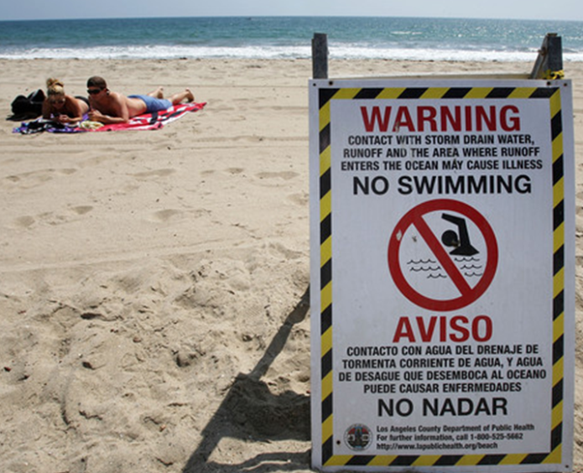
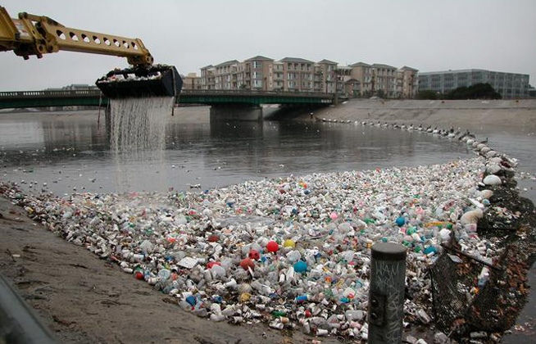
Flood Control system is an efficient and effective conveyance of stormwater, but it does not generate pollution

Slide 5
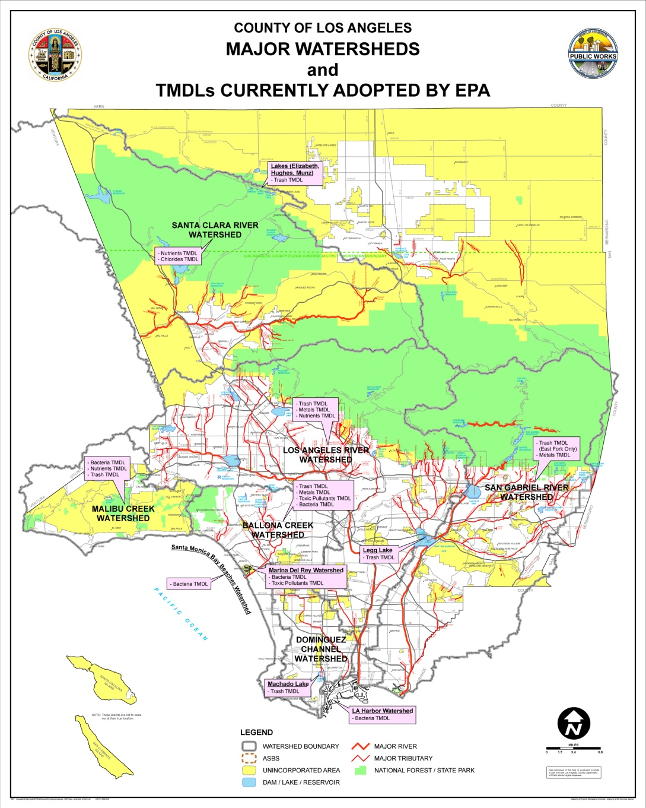
State of Surface Water Quality in Los Angeles County
Every major water body impaired and regulated
23 current TMDLs in effect
5 additional TMDLs in development
More TMDLs contemplated
LACFCD will no longer the principal permittee
Each city will be a permittee responsible for compliance
San Gabriel River
Metals TMDL
Los Cerritos Channel
Metals TMDL
Machado Lake
Trash TMDL
Nutrients TMDL

Slide 6

How to Pay for It??
Price tag to address TMDLs =
$$$$ billions to municipalities
Limited local, State and Federal funding
No-dedicated funding
Municipalities have many competing priorities
Santa Monica, Pasadena, Santa Clarita, RPV…
Cross-Jurisdictional Pollution

Slide 7
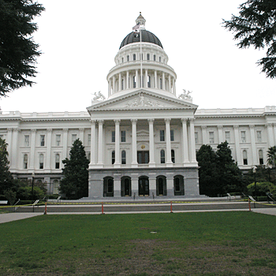
Assembly Bill 2554
  Amended the Los Angeles County Flood Control Act
  Gives LACFCD authority to charge a water quality fee
  Fee must be parcel-related
  Creates 9 regional Watershed Area Groups (WAGs)
  50/40/10 revenue allocation formula
  Requires an implementation ordinance

Slide 8
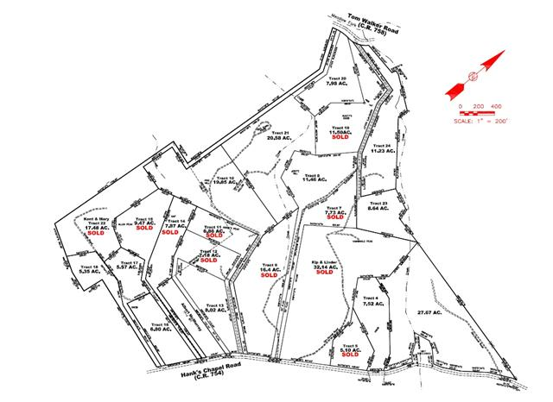
Parcel Based Fee
All Parcels Pay
  Residential
  Commercial
  Industrial
  Government
  …If it rains on your parcel, you’re likely contributing to water quality issues.

Slide 9
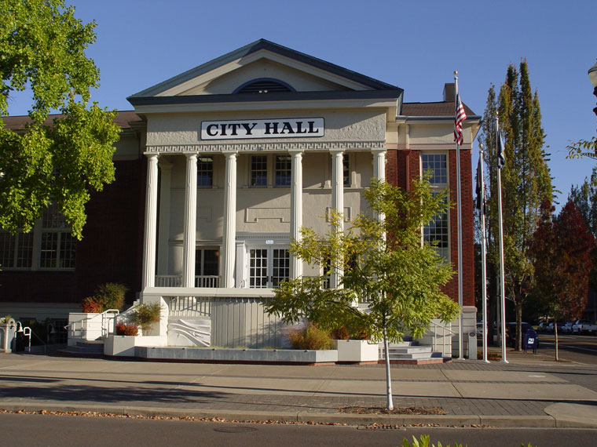
Municipalities
40% Local Return to Cities
Local Projects & Fixes
Maintenance of New & Existing Water Quality Facilities
Funds Distributed Automatically

Slide 10
  Projected Typical Local Return to Cities*
CITY | ESTIMATED ANNUAL REVENUE
Santa Clarita | $4,040,000
Burbank | $1,440,000
Pomona | $2,050,000
Baldwin Park | $720,000
Pico Rivera | $820,000
South Gate | $875,000
City of Los Angeles | $37,140,000
* Based on typical SFR fee of $54

Slide 11
Watershed Area Groups

Slide 12


Watershed Area Groups (WAGs)
50% Return to Watershed Area Groups
Regional Fixes
New Water Quality Projects
Requirement to Develop a
Water Quality Improvement Program
WAG Members = Municipalities within that WAG
WQIP
--
--
--

Slide 13
  Projected Typical Return to WAGs*
WAG | ESTIMATED ANNUAL REVENUE
Ballona Creek | $13,500,000
Dominguez Channel | $13,200,000
Lower San Gabriel River | $17,200,000
Santa Clara River | $14,800,000
Upper San Gabriel River | $17,500,000
* Based on SFR fee of $54

Slide 14
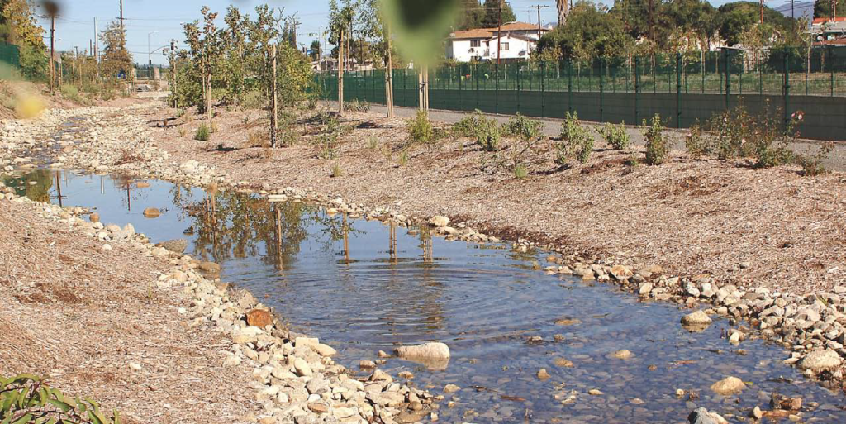
FLOOD CONTROL DISTRICT
10% to Flood Control District
Program Administration
Enhanced System-wide WQ Monitoring
LACFCD WQ Projects & Programs
Assistance to Municipalities & WAGs

Slide 15
How Do We Make It Happen??

Slide 16

Proposition 218 Election Process
Registered Voters
Election
Property Owner Election
66.7%
50% + 1

Slide 17
District-wide Support for the Fee
(May 2009)
(April 2011)

Slide 18
Support by Watershed (2011)

Slide 19
Key Components of the Ordinance
ORDINANCE
Certification Process
Oversight
Project Criteria & Eligibility
WAG Governance
Fee Structure
WAG Boundaries
Program Mechanics

Slide 20
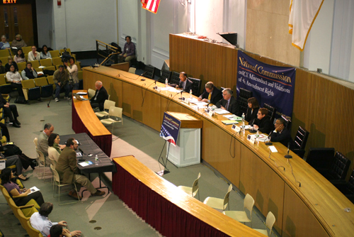
Oversight Board
Governance
Eleven members:
  9 from WAGs (1 each)
  1 from FCD
  1 from NGOs
Purpose
Review WQIPs, make
recommendations to
BOS on Certification (Project & Program Eligibility)
Review Overall Program
Specific Technical Qualifications
  for Members

Slide 21
  Next Steps
  Ordinance review & comment
  Engineer’s Report (Fee Calculation/Justification)
  Elections

Slide 22
Thank You
Questions?
http://dpw.lacounty.gov/lacfcd/wqfi/

